Slide 1
Sensi™ Smart Thermostat

Slide 2
Business and Product Overview

Slide 3
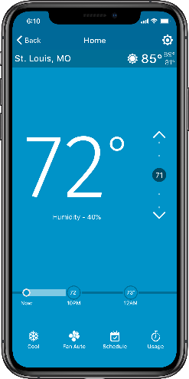
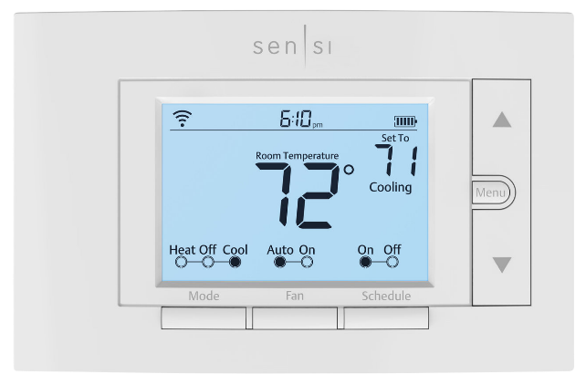
Introduction
The award-winning Sensi Smart Thermostat keeps homeowners connected to comfort and keeps you connected to your customers.
A BRAND YOU CAN TRUST
Sensi is highly-rated by customers for its simplicity. Our smart thermostats are ENERGY STAR® certified and recently named ENERGY STAR Partner of the Year for 2020. Sensi was also awarded ‘Best Overall’ & ‘Best Value’ smart thermostat by USA Today’s Reviewed.com.
CONNECT TO CUSTOMERS
Contractor branding in-app & smart alerts put your company information at your customers' fingertips. So, when they need service — you're just a tap away. Plus, connect with new customers through our Sensi Find A Pro tool.
SIMPLE & RELIABLE
Easy installation saves time and money on jobs, no matter
the skill level of the technician. Reduce callbacks with a
high-quality product that is easy for the homeowner to use.
Sensi 1F87U-42WF

Slide 4
Introduction
PARTNER OF THE YEAR
Energy Star
Sensi is the first and only smart thermostat to receive this honor
This award is the highest level of recognition by the U.S. Environmental Protection Agency and demonstrates our commitment to energy efficiency
READER’S CHOICE
PCMAG.com
Outperformed Ecobee,
Honeywell, and Nest
Highest rated for overall satisfaction
Highest rated for setup
Highest rated for value
Highest rated for ease of use
Highest rated for energy savings
BEST VALUE SMART THERMOSTATS
USA Today’s Reviewed.com
Winner for four consecutive years
Sensi Smart Thermostats consistently receive outstanding reviews for its simple installation, intuitive app design and highly-rated customer support.
“With support for Amazon Alexa, Apple HomeKit, Google Assistant and Wink, the Sensi Touch has a solid roster of smart home partners – and an updated touchscreen display.”
“The Emerson Sensi Thermostat is one of the best values in the marketplace right now.”
“This nicely priced smart thermostat offers geofencing, seven-day scheduling, temperature and humidity alerts, and energy reports.”
“…easy to install, and can help you save about 23 percent on HVAC related energy costs.”
ENERGY STAR COMPLIANT

Slide 5
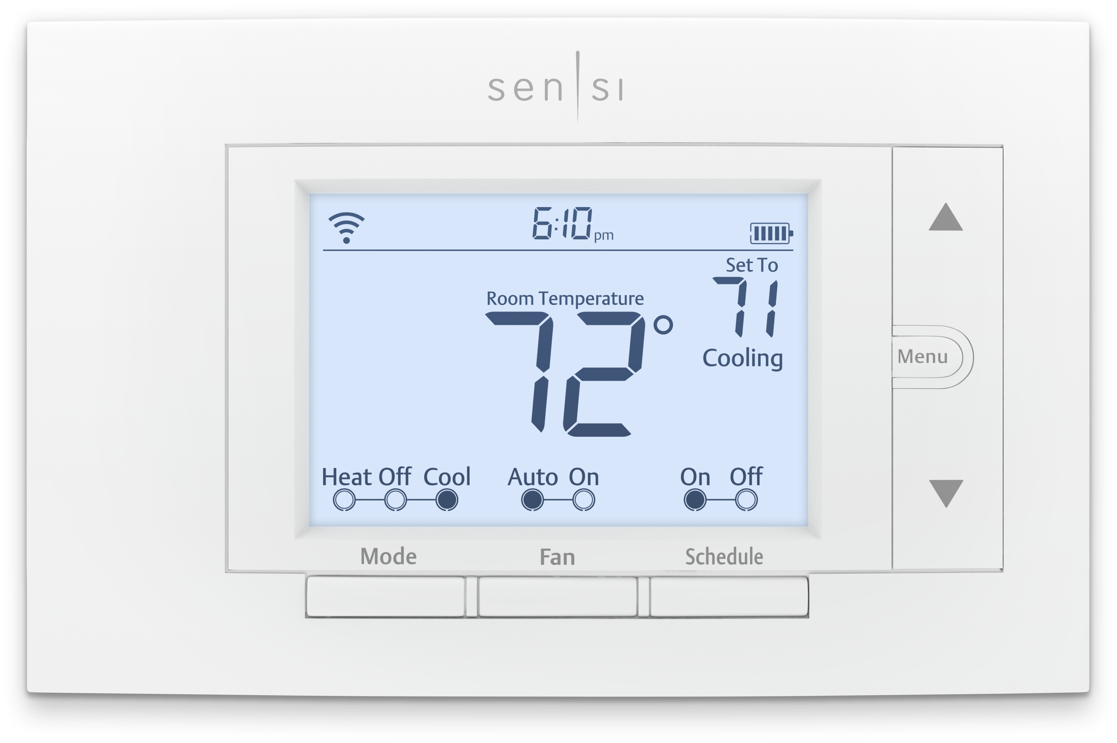
Features Overview
Sensi Customers Love the Features that Help Them Save About 23% on HVAC Energy*
REMOTE ACCESS
Set, change, and program home comfort from anywhere
HUMIDITY CONTROL
Homeowners stay comfortable with humidification/
dehumidification control
USAGE REPORTS
Monitor current day and historical heating, cooling,
and fan runtimes right in the app
FLEXIBLE SCHEDULING
Program a schedule for each day of the week
CIRCULATING FAN
Select a minimum daily fan run time % to help
regulate temperature and improve indoor air quality
SMART ALERTS
Detects extreme temperatures and humidity levels
and lets you know if your system isn’t working properly,
even when you are not at home
SERVICE REMINDERS
The Sensi app will remind you when it’s time for a new
air filter and other HVAC maintenance
ENERGY STAR AND
TITLE 24 COMPLIANT
* Energy savings are calculated by comparing operation time for a nationwide sample of Sensi users with temperature adjustments averaging 4° in comparison to users with no adjustments. Savings vary based on equipment type/condition, insulation, climate & temperature adjustment size/frequency.

Slide 6
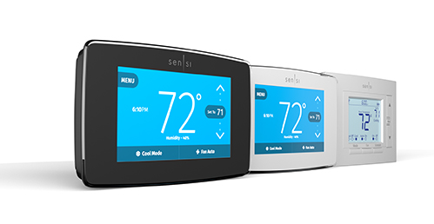
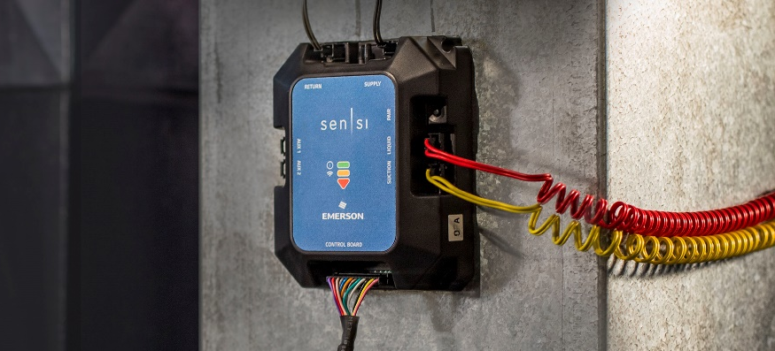
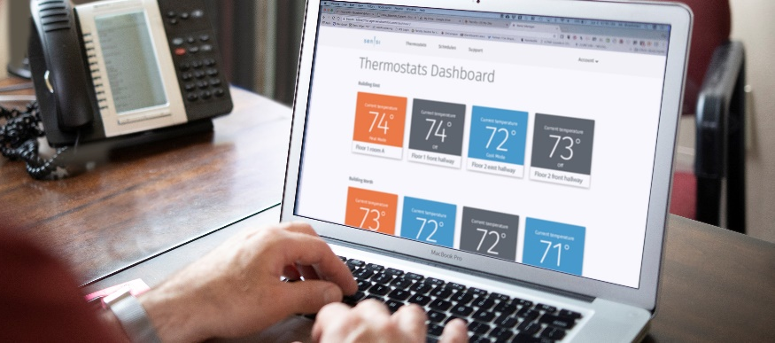
Sensi Family Overview
SENSI SMART THERMOSTATS
Easy install for you, upgraded features and
convenient comfort for your homeowners.
The award-winning Sensi Smart Thermostat keeps homeowners connected to comfort and keeps you connected to your customers.
Sensi Partners get access to program benefits including homeowner leads, contractor branding, custom literature and free online training.
SENSI PREDICT™
Enable remote predictive
diagnosis to increase profitability
Technology comes to HVAC to deliver greater contractor efficiencies and a deeper homeowner connection.
SENSI MULTIPLE THERMOSTAT MANAGER
Light commercial solutions for simple comfort control
Sensi™ Multiple Thermostat Manager gives facility managers the power to control all their Sensi thermostats in one place.

Slide 7
Sensi Family Overview Continued
SENSI SMART THERMOSTATS
SENSI PREDICT™
SENSI MULTIPLE THERMOSTAT MANAGER
CONTRACTOR-ON-CALL
The Sensi app stores your contact information so when your customer
needs service, you’re just a tap away. Register at sensiregistration.com.
EASY TO INSTALL & CONNECT
No common wire (c-wire) required for most installations¹ Step-by-step guide
in the Sensi app.
SAVE ABOUT 23% ON
HVAC ENERGY²
By adjusting the temperature using
flexible scheduling, remote access, and geofencing, Sensi customers saved about 23% on HVAC energy usage.
CUSTOM SENSOR TECHNOLOGY
10 professionally installed sensors and live data deliver analysis of 32 functions, enabling Know Before You Go service.
HOMEOWNER REPORTS
Contractor branded homeowner portal summarizes performance including alerts, runtime, estimated cost and filter status.
REAL-TIME ALERTS
When HVAC issue arises, messaging notifies homeowners and contractors to coordinate verified needed repairs.
CONTROL THERMOSTATS
AT MULTIPLE LOCATIONS
Customers monitor and adjust all of their thermostats in one convenient place.
GROUP SCHEDULING WITH
BATCH OPERATIONS
Easily consolidate and customize settings across multiple thermostats by grouping and sorting.
KEYPAD LOCKOUT
Perfect settings are kept on lock down by disabling changes from individual thermostats or group of thermostats.
¹ A common wire (c-wire) is required for Apple Homekit, heat only systems, cool only systems and heat pump systems.
² Energy savings are calculated by comparing operation time for a nationwide sample of Sensi users with temperature adjustments averaging 4° in comparison to users with no adjustments.
Savings vary based on equipment type/condition, insulation, climate & temperature adjustment size/frequency.

Slide 8
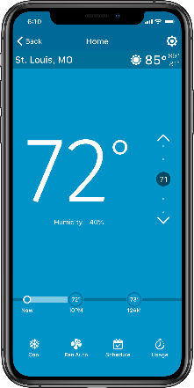
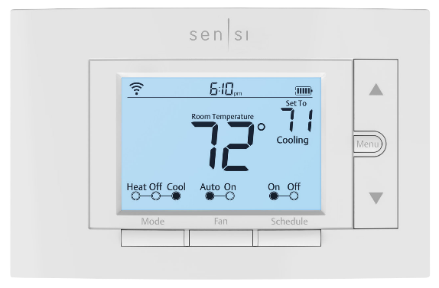
Why Convert from the Competition?
No c-wire required for most applications
Easy to use – reduces callbacks
Universal system compatibility – one model for most system types
Highest rated smart thermostat app
Award winning brand
Sensi 1F87U-42WF
Support team hours
Monday-Friday 7am-7pm (CST) Saturday-Sunday 8am-5pm (CST)
888-605-7131
SENSI SUPPORT WHEN & WHERE YOU NEED IT

Slide 9
What Homeowners Say
“I would recommend this thermostat to everyone looking for ease of use and wanting to save on energy bills.”
"Programming features are ample, and we have cut our energy bills by 40% since installation. Highly recommended!"
“This is a company that stands behind their products and puts the customers first.”

Slide 10
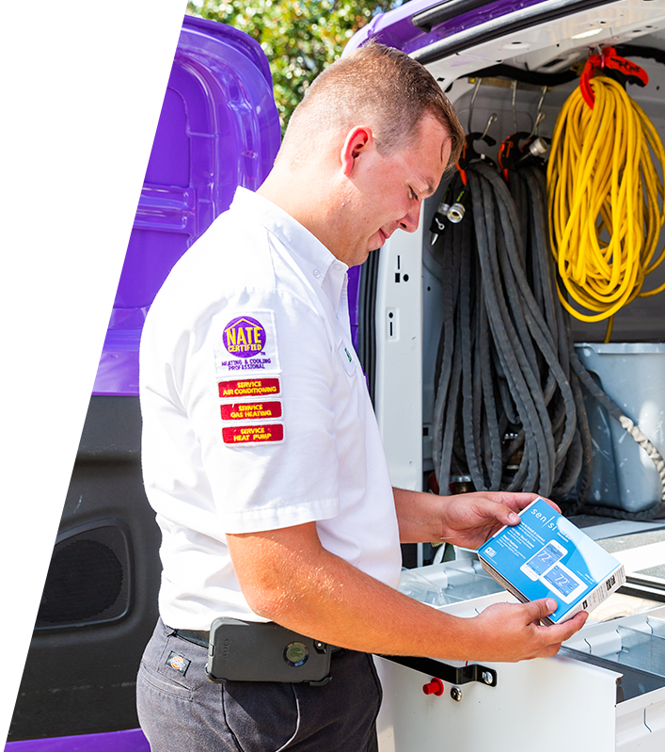
What Professionals Say
"Emerson is a leader in our industry. They created the Wi-Fi thermostat for the contractor that is going to work for the homeowner.”
"Sensi is the go-to product you can recommend easily and know it's going to go well for that customer.”
"Homeowners love having that access and ability to get on the phone and put their thermostat to whatever temperature they want it to be.”
– Jane Molina and Joy Williams
Owners Williams Heating & Cooling
– Ted Konechne
VP of HVAC Support
L&S Mechanical
– Justin Morgan
Lead HVAC Technician
Williams Heating & Cooling

Slide 11
Business case (Drives Business Opportunity)
Placeholder for contractor’s comments on how it drives their business, increases their sales etc opens up other opportunity - Digital Branding??? Case Studies

Slide 12
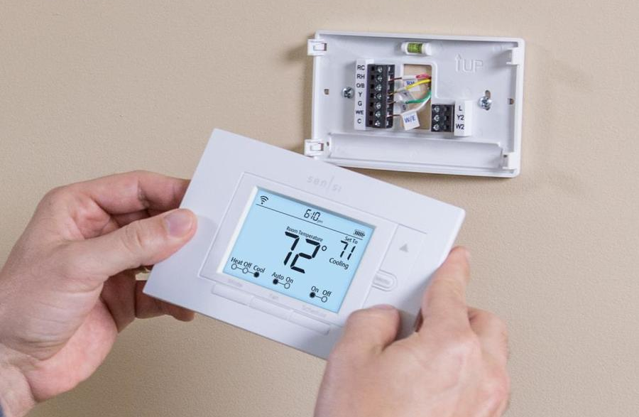
Sensi Smart Thermostat at a Glance
Sensi Smart Thermostat Universal – 4 Heat/2 Cool
PROGRAMS |  | STAGES BY SYSTEM |  |  | MODEL NUMBER | APPLICATIONS |  |  | POWER SOURCE
Program Options | Periods Per Day | Single Stage | Multi Stage | Heat Pump | 1F87U-42W | Gas/Oil/ Electric | 3 Wire Zone Valve (requires common) | Humidity Control (Humidifier/ Dehumidifier) | Power Methods
7, NP, Geofencing | 8 Max | 1H/1C | 2H/2C | 4H/2C
 |  |  |  |  |  |  |  |  | Hardwire, Battery & Power Sharing
Universal (Single Stage, Multi-Stage, Heat Pump compatible)
Dual Fuel – No outdoor sensor required
Professional 5 year warranty
Terminal Designations
RC
RH
C
W/E
W2/*
Y
Y2/*
O/B
G
L

Slide 13
Sensi Smart Thermostat Features
Sensi Partners get access to program benefits including homeowner leads, contractor branding, custom literature and free online training. Learn more at emerson.com/sensipartner
ENERGY STAR AND TITLE 24 COMPLIANT
EASY TO INSTALL & CONNECT
No common wire (c-wire) required for most
installations. Step-by-step guide in the Sensi app.
CONTRACTOR MODE
Use Contractor Mode to scan the barcode on any
Sensi thermostat and register it to your company.
No Wi-Fi required at installation.
CONTRACTOR-ON-CALL
Be the contractor on call in customers monthly
usage reports, service reminders, smart alerts
and in-app. Register at sensiregistration.com.
SMART ALERTS
Notifies customers of extreme temperature
and humidity levels.
HUMIDITY CONTROL
Help homeowners stay comfortable with humidification/dehumidification control.
SAVE ABOUT 23% ON HVAC ENERGY
By adjusting the temperature using flexible
scheduling, remote access, and geofencing,
Sensi customers save about 23% on HVAC energy.
USAGE REPORTS
Monitor current day and historical heating,
cooling and fan runtimes right in the app.
CIRCULATING FAN
Select a minimum daily fan run time percent to help regulate temperature and improve indoor air quality.
KEYPAD LOCKOUT & TEMPERATURE LIMITS
Maintain total control by setting temperature limits and disabling changes by others at the thermostat.
SMART HOME COMPATIBLE
Compatible with smart home platforms Amazon Alexa,
the Google Assistant, Apple HomeKit and SmartThings.

Slide 14
Packaging Design Aids Selection/Application
Applications:
Universal for Heat Pump or Conventional Systems
Heat Pump Stages up to 4H/2C
Multi-Stage Conventional up to 2H/2C
Single Stage Conventional – 1H/1C
Terminal Designations
RC
RH
C
W/E
W2/*
Y
Y2/*
O/B
G
L
To verify thermostat features, look at the side panel of the box.
Model | Program Options |  |  | Max Stages Heat/Cool |  | Applications |  |  |  | Power Source |  | Selectable Performance Features |  |  |  |  |  | Comfort & Convenience Features
Model Number
1F87U-42WF |  |  |  | 2/2 | 4/2
WiFi-Control/
Smart Home Qualified
3 Wire Zone (c-wire required)
EMR/Early
Start Program
Filter Change
Reminder
Cont. Backglow
w/Common
Auto Changeover
Auto DST Adjust
Circulating Fan
7 Day
Multivolt
Hardwired (24V)
Non-Programmable
Heat Pump
Gas/Oil/Electric
PTAC Compatible
Remote Sensor
Permanent Memory
Dual Fuel Control
Keypad Lockout
Conventional
Battery
Humidity Control
Temperature Limits

Slide 15
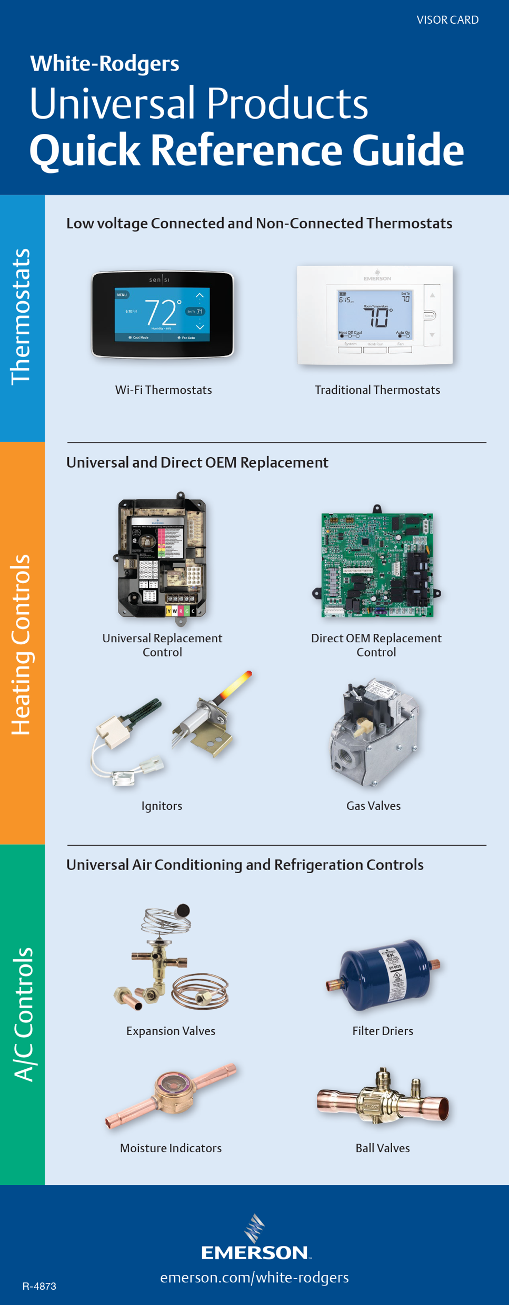
Quick Reference Guide
Be sure to check out our Quick Reference guide with all of our thermostats, available on our Wholesale Resource Center:
https://climate.emerson.com/documents/wr-0889-visorcard-divide-en-3599656.pd
The White-Rodgers Quick Reference Guide includes specs and features on all thermostats including:
1
System type
2
Features
3
Terminals

Slide 16
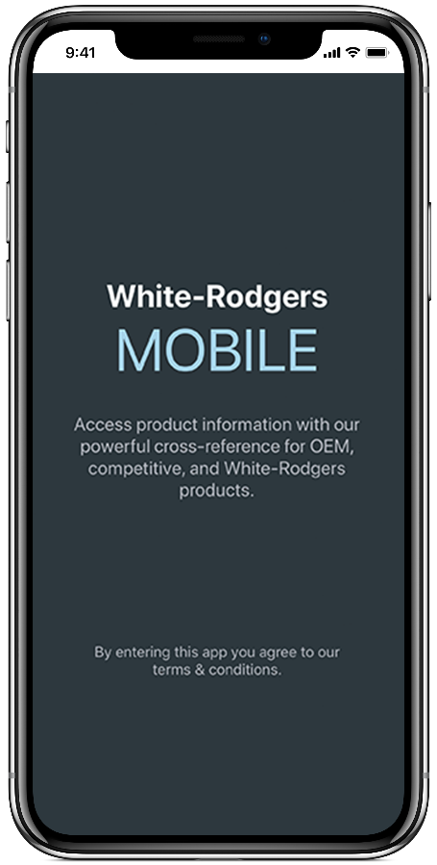
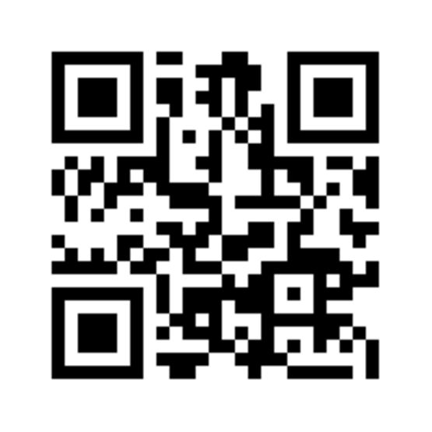
WR Mobile App
Always Up-to-date And Easy To Use:
Mobile App
White-Rodgers Website
Your resource for:
Product information and spec sheets
Complete Cross Reference
OEM compatibility
Installation information and videos
Wiring diagrams
Download:
Go to your app store
Type in WR Mobile
Install the app
OR
Open your camera
Hold it over the QR code
Tap “Open” on the pop-down
Install the app

Slide 17
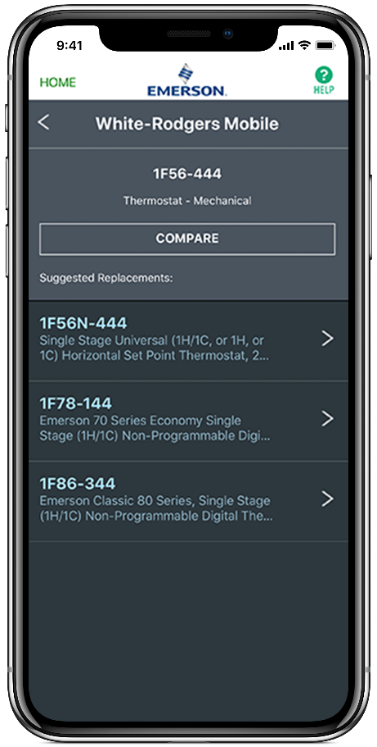
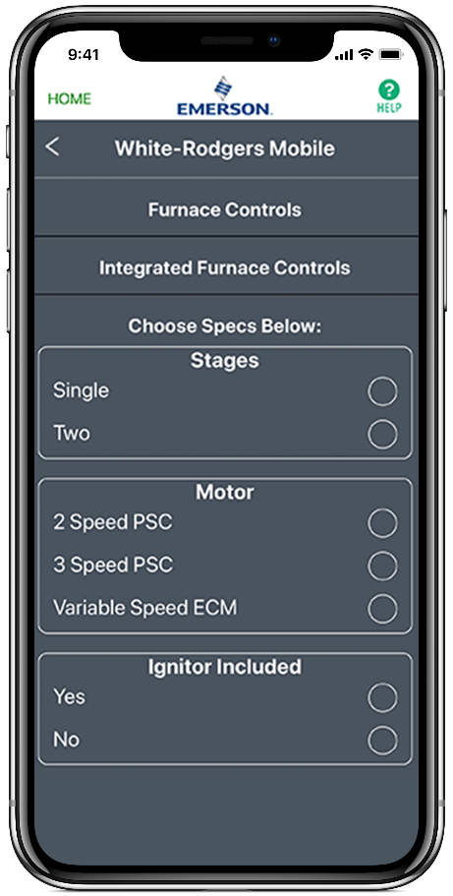
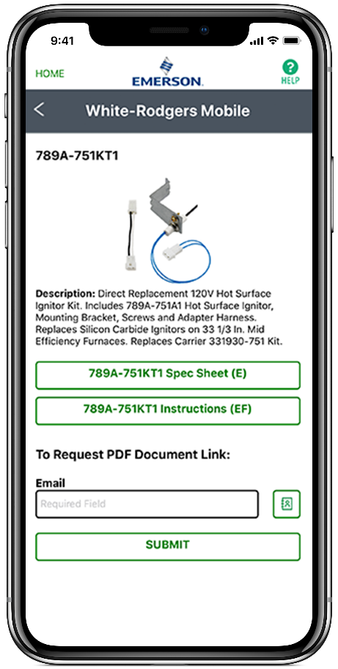
WR Mobile App
Easy to use!
Search by OEM, competitive, or White-Rodgers model number.

Slide 18
White-Rodgers Cross Reference
Go to: www.whiterodgers.com
Hover over tools & resources
Click on: White-Rodgers cross reference/product information
Enter the model number or click on: Search Replacement Heating Controls by Major OEM Brand

Slide 19
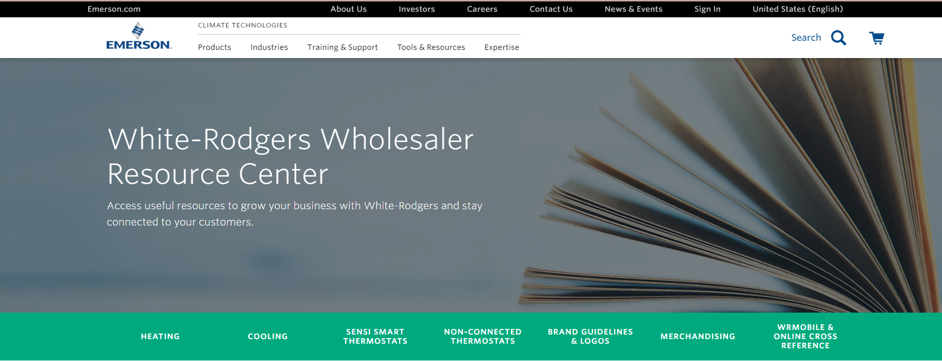
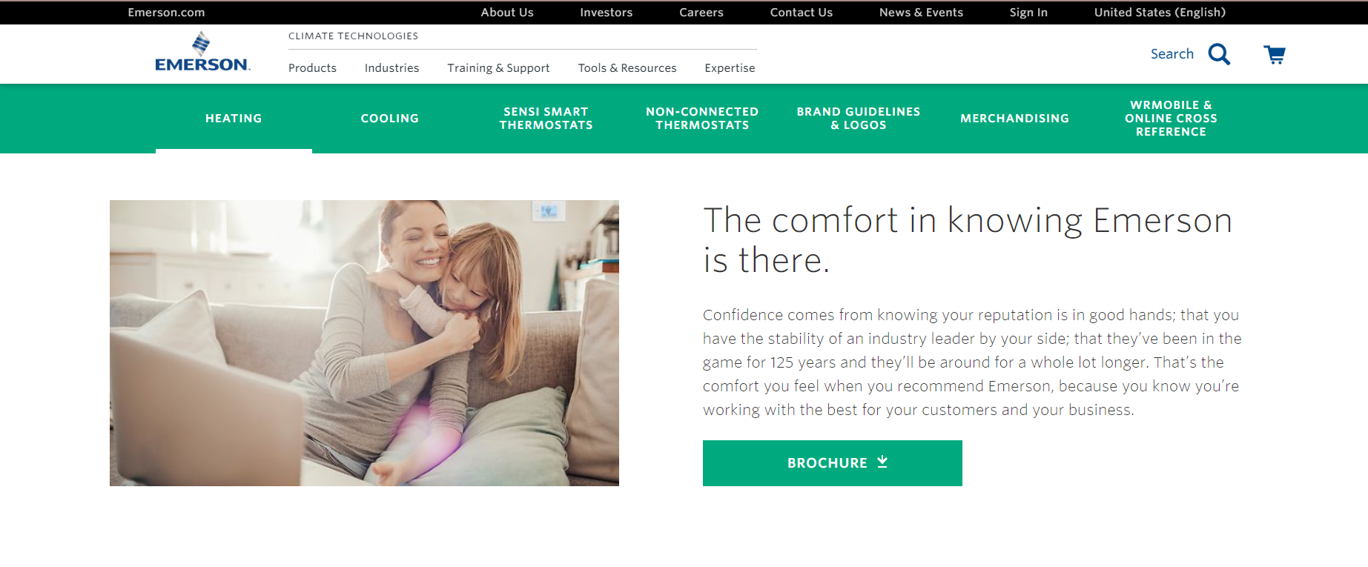
Wholesale Resource Site
Access useful resources to grow your business.
Visit: https://climate.emerson.com/en-us/brands/white-rodgers/white-rodgers-wholesaler-resource-center
You’ll find videos, stocking lists and product launch information for Sensi products:
Sensi Smart Thermostats
Traditional Thermostats
Heating/Cooling Products
Contractor Rewards
Product Merchandising

Slide 20
Why Contractors Trust White-Rodgers
Industry Leading Products
Used by more OEM’s
Offering the widest range of Universal Replacement Controls
Ease Of Installation
Simple, easy to understand instructions
Product Reliability
Quality Control assures reliable products
Affordable
Competitive pricing
Supported By Knowledgeable Representatives
Contractor direct phone support

Slide 21
Technical

Slide 22
Introduction
The award-winning Sensi Smart Thermostat keeps homeowners connected to comfort and keeps you connected to your customers.
A BRAND YOU CAN TRUST
Sensi is highly-rated by customers for its simplicity. Our smart thermostats are ENERGY STAR® certified and recently named ENERGY STAR Partner of the Year for 2020. Sensi was also awarded ‘Best Overall’ & ‘Best Value’ smart thermostat by USA Today’s Reviewed.com.
CONNECT TO CUSTOMERS
Contractor branding in-app & smart alerts put your company information at your customers' fingertips. So, when they need service — you're just a tap away. Plus, connect with new customers through our Sensi Find A Pro tool.
SIMPLE & RELIABLE
Easy installation saves time and money on jobs, no matter
the skill level of the technician. Reduce callbacks with a
high-quality product that is easy for the homeowner to use.
Sensi 1F87U-42WF

Slide 23
Packaging Design Aids Selection/Application
Applications:
Universal for Heat Pump or Conventional Systems
Heat Pump Stages up to 4H/2C
Multi-Stage Conventional up to 2H/2C
Single Stage Conventional – 1H/1C
Terminal Designations
RC
RH
C
W/E
W2/*
Y
Y2/*
O/B
G
L
To verify thermostat features, look at the side panel of the box.
Model | Program Options |  |  | Max Stages Heat/Cool |  | Applications |  |  |  | Power Source |  | Selectable Performance Features |  |  |  |  |  | Comfort & Convenience Features
Model Number
1F87U-42WF |  |  |  | 2/2 | 4/2
WiFi-Control/
Smart Home Qualified
3 Wire Zone (c-wire required)
EMR/Early
Start Program
Filter Change
Reminder
Cont. Backglow
w/Common
Auto Changeover
Auto DST Adjust
Circulating Fan
7 Day
Multivolt
Hardwired (24V)
Non-Programmable
Heat Pump
Gas/Oil/Electric
PTAC Compatible
Remote Sensor
Permanent Memory
Dual Fuel Control
Keypad Lockout
Conventional
Battery
Humidity Control
Temperature Limits

Slide 24
Sensi Smart Thermostat Connections
 | CONVENTIONAL SYSTEM CONNECTION | HEAT PUMP SYSTEM CONNECTION
RC | Power for cooling, 24 V
RH | Power for heating, 24V
C | Common wire, 24V
Y | 1st stage cool | 1st stage heat and cool (or humidifier)
Y2/* | 2nd stage cool (or humidifier) | 2nd stage heat and cool (or humidifier)
W/E | 1st stage heat | 1st stage auxiliary/emergency heat
W2/* | 2nd stage heat (or dehumidifier) | 2nd stage auxiliary/emergency heat (or dehumidifier)
G | Indoor blower (fan)
O/B | 3-wire hot water zone valve, zone panel or heat pump changeover connection. (configurable as O, B, or 2 in the installer menu) | Heat pump changeover (reversing valve) connection (configure as O or B in the installer menu)
L | No function | “L” terminal connection

Slide 25
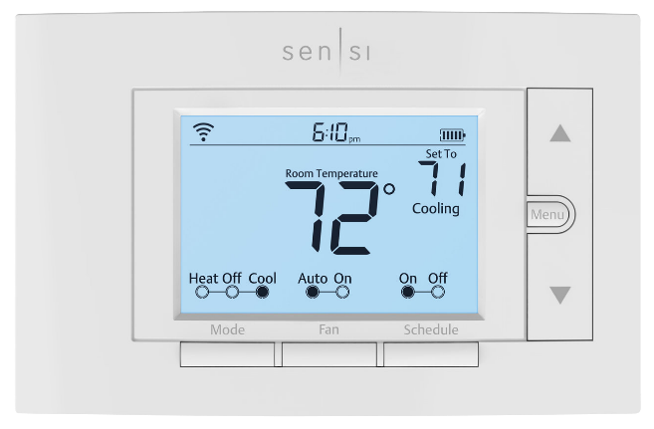
Thermostat Navigation
1
2
3
4
5
6
7
10
8
9
13
12
11
1
WI-FI STATUS ICON
5
BATTERY
9
13
MODE BUTTON
(Auto Mode is only available through the Sensi™ app)
DOWN BUTTON
2
6
BACKLIGHT BUTTON
UP BUTTON
10
ROOM TEMPERATURE
7
3
TIME
SET TEMPERATURE
11
SCHEDULE BUTTON
4
KEYPAD LOCKOUT ICON
8
MENU BUTTON
12
FAN BUTTON

Slide 26
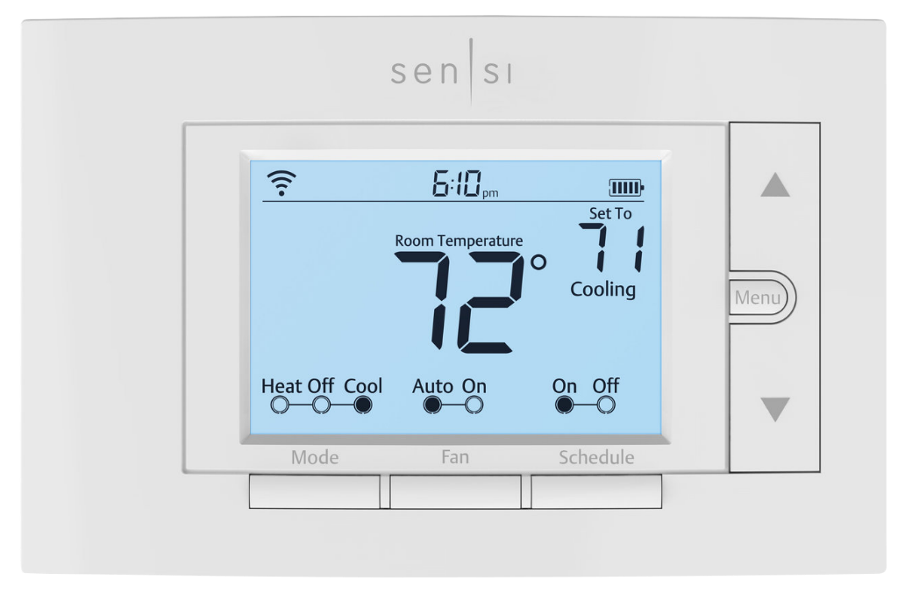
System Configuration Menu
Press Menu.
This will display the first item in the configuration menu. Press Menu to advance to the next menu item.
Press the UP or DOWN buttons to change a menu item option.
TECH TIP: Most technical service calls are the result of improper system configuration. Ensure you reference your installation guide for appropriate system selection during installation.
1F87U-42WF

Slide 27
Configuration Options Summary
DISPLAY CODE | MENU ITEM | CONFIGURATION OPTIONS
- | Wireless Setup Connects Thermostat to Wi-Fi network | Connect
F | Fahrenheit or Celsius | F, C
AC2 | Outdoor Equipment Configuration A/C or Heat Pump | AC1 – Conventional Cooling 1 (Single Stage) AC2– Conventional Cooling 2 (Two-Stage) HP1 – Heat Pump 1 (Single Stage) HP2– Heat Pump 2 (Two-Stage) AC0– No Cooling
EL2 | Indoor Equipment Configuration Gas or Electric Heat | EL1– Electric 1 (Single Stage) EL2– Electric 2 (Two-Stage) Fan Only GA1 Gas 1 (Single Stage) GA2 Gas 2 (Two-Stage)
O | Reversing Valve Position “O”, "B” or 3-Wire Zone Valve "2" | O (energized constantly in cool) B (energized constantly in heat) 2 (energized constantly when not calling for heat)
Fn OFF | Comfort Circulating Fan | Off/10% – 100% (5% increments)
H AA OFF | Humidification Add Accessory | Off/On
H SP OFF | Humidification Set Point | Off/5% – 50% (5% increments)
dH AA Od | Dehumidification Add Accessory | Od/Oc Od – Optimal dehumidification (Overcool to dehumidify) Oc – Optimal comfort (Wired dehumidification)
dH SP OFF | Dehumidification Set Point | Off/40% – 95% (5% increments)
ON | Wireless Radio Turns Wi-Fi Radio On/Off | Off/On

Slide 28
Configuration Options In App
FEATURE | DESCRIPTION
Remote Access | Adjust, control, schedule or monitor from anywhere, anytime
Usage Reports | Monitor current day and historical heating, cooling and fan run times
Contractor-On-Call | Contact your HVAC Pro when you need service
Dashboard | View and control multiple thermostats
Geofencing | Switches settings between Home or Away based on your location
Program a Schedule | Create one, or multiple time/temperature setting schedules
Keypad Lockout | Lock out changes at the thermostat but retain Wi-Fi control
Temperature Limits | Allow thermostat adjustment only within the temperature range you select
Set Point Controls | Select the temperature range for automatic changeover between heat/cool
Boost | Allow fast staging when the temperature is adjusted 3 or more degrees
A/C Protection | Five minute time delay between cooling or heat pump cycles
Adjustable Cycle Rate | allows fast, medium or slow cycle rates
Temperature Offset | Adjust temperature display +/- 5°
Circulating Fan | Select daily fan run time percentage even if heat or cool is not running
Maintenance Reminder | Calendar Date or Usage (runtime)
Air Filter Reminder | Calendar Date or Usage (runtime)
UV Bulb Reminder | Calendar Date or Usage (runtime)

Slide 29
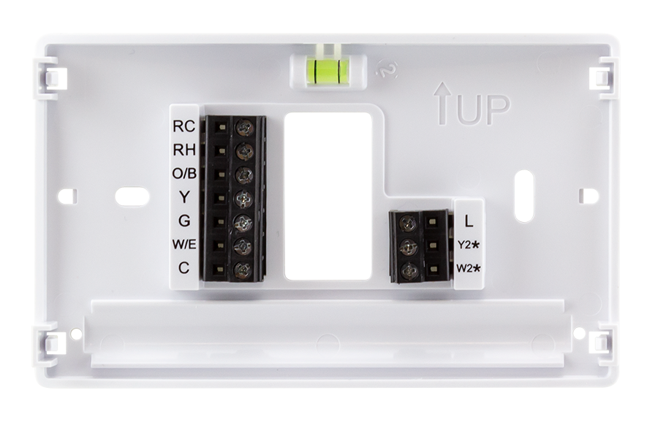
Humidity Control
If Sensi terminals Y2/* and W2/* are not used for multiple stage cool or heat they
can be configured for low voltage humidity control.
Y2/* configures to operate low voltage humidifiers and energizes on call for humidity with the call for heat
W2/* configures to operate low voltage dehumidification systems and
de-energizes on call for dehumidification
with a call for cool
Furnace/Air Handler
Terminal Strip
Humidifier
DHUM
W
Y
C
G
R
TECH TIP: Dehumidification can also be accomplished by configuring the thermostat to overcool up to 3° without additional wiring or dehumidification equipment.
Common
Line Voltage
Valve 24V
Hot
System
Transformer

Slide 30
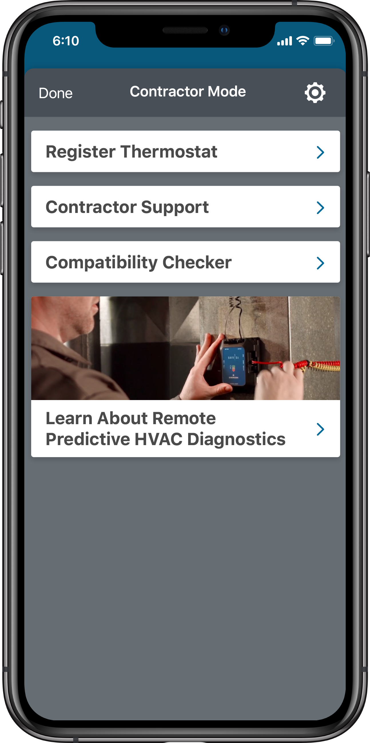
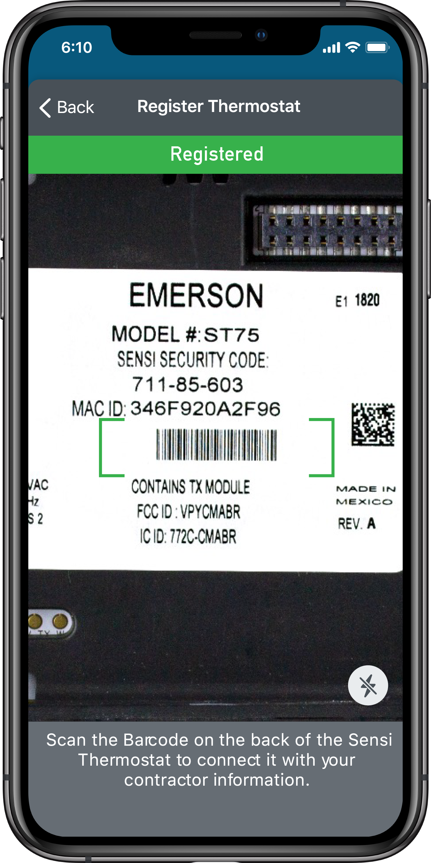
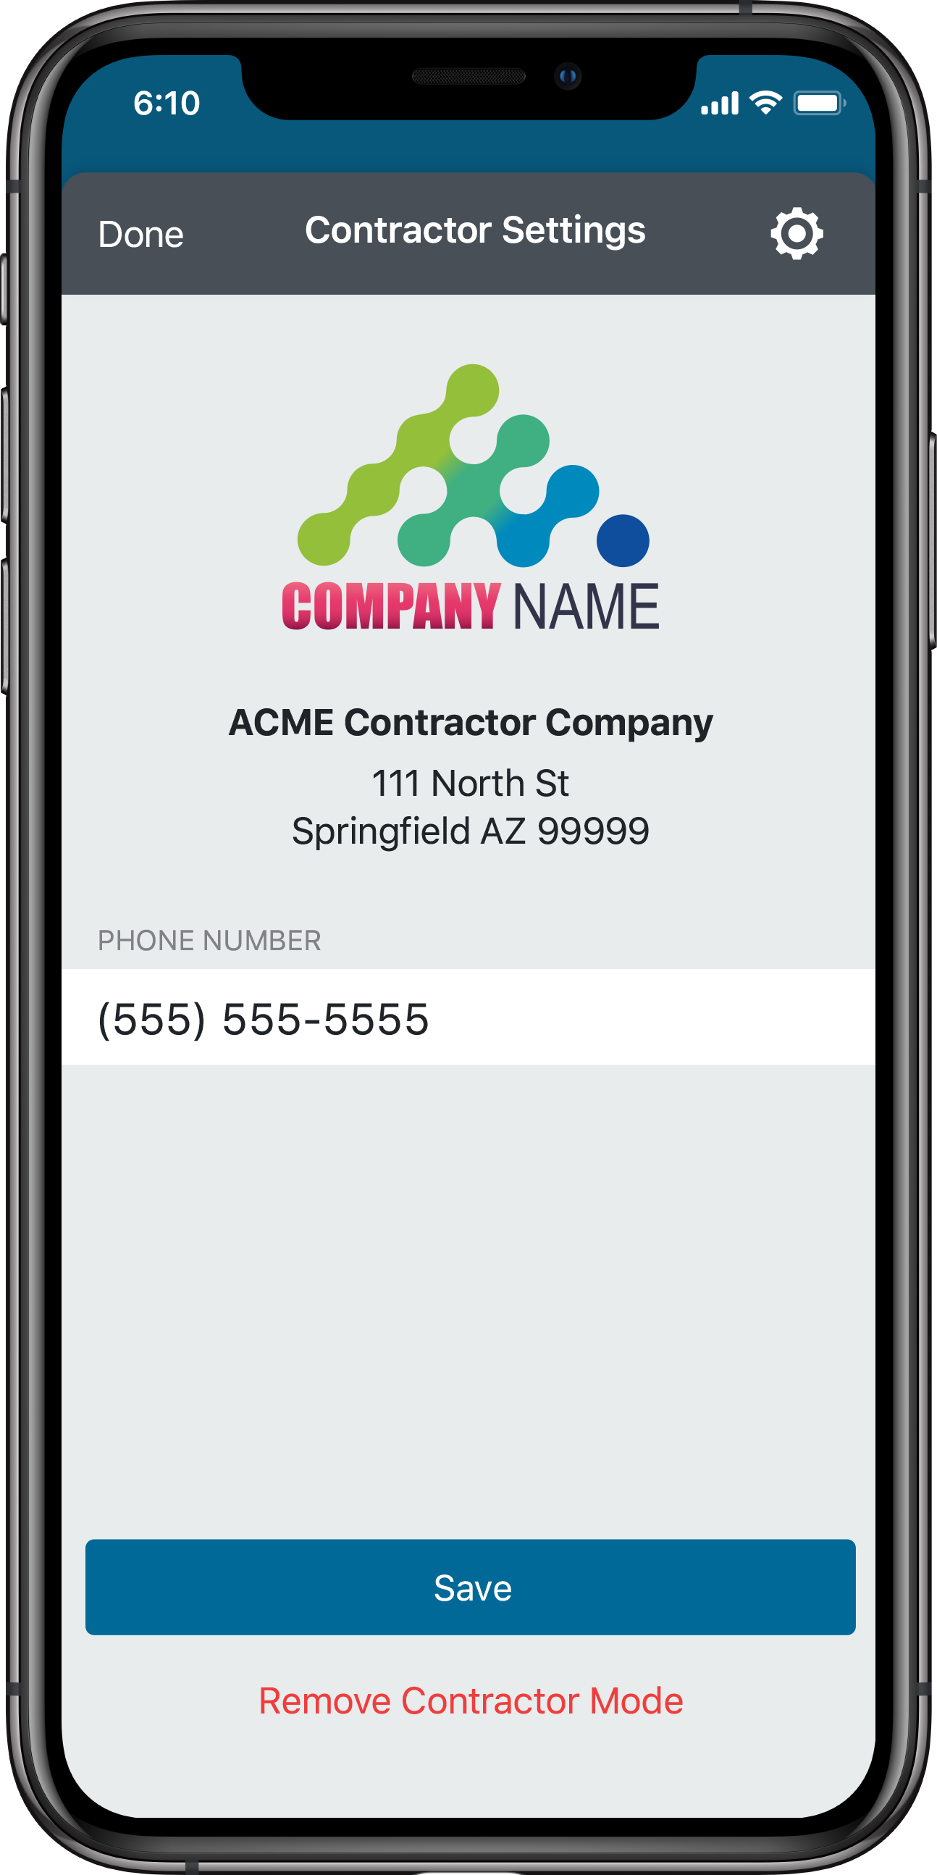
Contractor Mode
Contractor Mode lets Sensi Partners connect a thermostat to their business at installation, and digitally brand logo and contact info into their customer’s phones – even when Wi-Fi is temporarily unavailable.
TO REGISTER A THERMOSTAT:
Tap on Contractor Mode then "Register Thermostat”
Flip the thermostat face plate over so you can see the model number, MAC ID, and a bar code. Use the app to scan the bar code.
When the thermostat is online and registered, your phone number will be linked so that the customer can contact you directly from the app for service
1
2
3

Slide 31
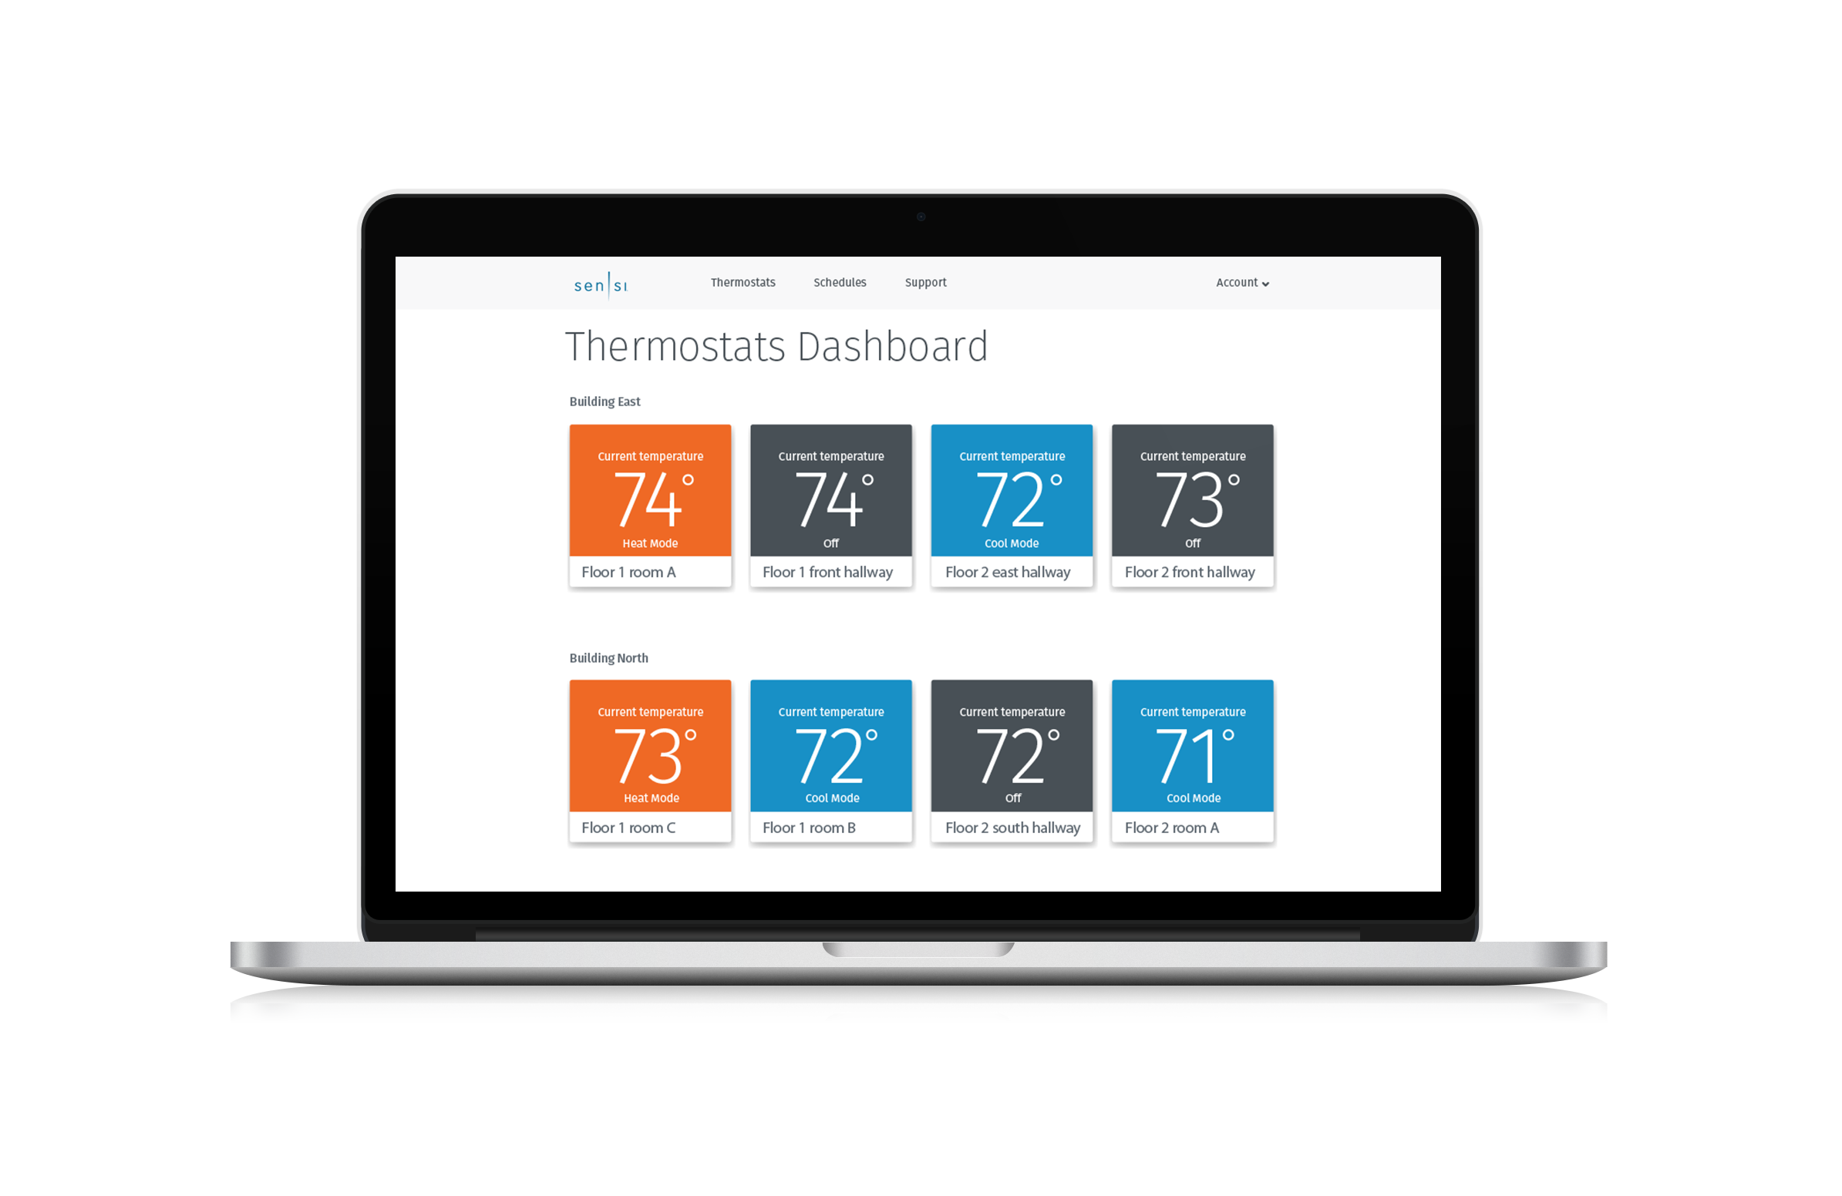
Sensi Multiple Thermostat Manager
For light commercial purposes, Sensi offers a software program that allows building managers to manage hundreds of thermostats at once, save energy and receive temperature and humidity alerts.
^{EXTENSIVE COMPATIBILITY}
Works with HVAC systems in most facilities. All customers need are our highly-rated Sensi Smart Thermostats.
^{SIMPLE & AFFORADABLE}
Easy setup process to manage comfort at a much lower cost than traditional building management systems.
CONTROL THERMOSTATS AT MULTIPLE LOCATIONS
Monitor and adjust all of your thermostats in one convenient place.
^{EASY-TO-USE PORTAL}
Access thermostat control from anywhere through the intuitive portal featuring drag-and-drop functionality.
GROUP SCHEDULING WITH BATCH OPERATIONS
Easily consolidate and customize settings across multiple thermostats by grouping and sorting.
^{SMART ALERTS}
Enable optional notifications that let you know when and where extreme temperature or humidity changes are detected.
^{ENERGY SAVING FEATURE}
Remote control and flexible batch schedule can minimize energy waste and help save you money.

Slide 32
Staging
Emerson multi-stage thermostats are equipped with a microprocessor that uses an algorithm to make decisions about bringing on an additional stage of heat or cool. The algorithm focuses on system performance, rather than only time or temperature, to determine when to engage 2nd stage.
More frequent calls, when the temperature exceeds the first stage differential, increasingly drive faster engagement of 2nd stage. Less frequent time outside the differential will delay calls for additional stages.
This is accomplished by microprocessor capture of the rolling average of room temperature, allowing the optimum staging point in time to be calculated.
Faster calls for 2nd stage, result in a quicker trigger for 2nd stage.
Slower calls for 2nd stage, result in slower trigger.

Slide 33
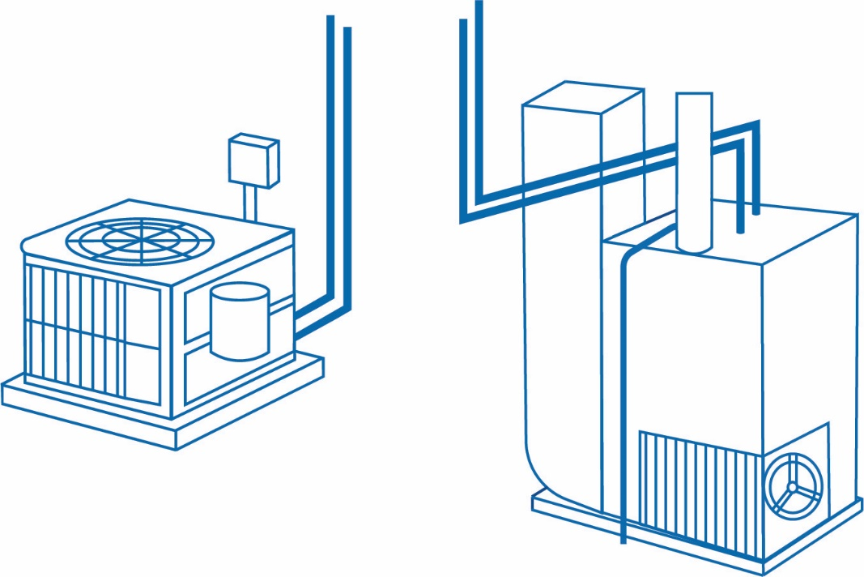
Dual Fuel
Dual Fuel systems combine a heat pump and gas furnace.
The Sensi Dual Fuel logic option allow the staging algorithm to determine the optimum time to stage to gas. They also allow the furnace time to complete the ignition sequence before switching off the pump to prevent cold air from being blown out the vents.
This algorithm doesn’t require an outdoor sensor because it tracks and monitors system performance, and then determines the optimal time to stage to the gas furnace.
Heat Pump
Gas Furnace

Slide 34
Install

Slide 35
Introduction
The award-winning Sensi Smart Thermostat keeps homeowners connected to comfort and keeps you connected to your customers.
A BRAND YOU CAN TRUST
Sensi is highly-rated by customers for its simplicity. Our smart thermostats are ENERGY STAR® certified and recently named ENERGY STAR Partner of the Year for 2020. Sensi was also awarded ‘Best Overall’ & ‘Best Value’ smart thermostat by USA Today’s Reviewed.com.
CONNECT TO CUSTOMERS
Contractor branding in-app & smart alerts put your company information at your customers' fingertips. So, when they need service — you're just a tap away. Plus, connect with new customers through our Sensi Find A Pro tool.
SIMPLE & RELIABLE
Easy installation saves time and money on jobs, no matter
the skill level of the technician. Reduce callbacks with a
high-quality product that is easy for the homeowner to use.
Sensi 1F87U-42WF

Slide 36
Sensi Smart Thermostat at a Glance
Sensi Smart Thermostat Universal – 4 Heat/2 Cool
PROGRAMS |  | STAGES BY SYSTEM |  |  | MODEL NUMBER | APPLICATIONS |  |  | POWER SOURCE
Program Options | Periods Per Day | Single Stage | Multi Stage | Heat Pump | 1F87U-42W | Gas/Oil/ Electric | 3 Wire Zone Valve (requires common) | Humidity Control (Humidifier/ Dehumidifier) | Power Methods
7, NP, Geofencing | 8 Max | 1H/1C | 2H/2C | 4H/2C
 |  |  |  |  |  |  |  |  | Hardwire, Battery & Power Sharing
Universal (Single Stage, Multi-Stage, Heat Pump compatible)
Dual Fuel – No outdoor sensor required
Professional 5 year warranty
Terminal Designations
RC
RH
C
W/E
W2/*
Y
Y2/*
O/B
G
L

Slide 37
Sensi Smart Thermostat Connections
 | CONVENTIONAL SYSTEM CONNECTION | HEAT PUMP SYSTEM CONNECTION
RC | Power for cooling, 24 V
RH | Power for heating, 24V
C | Common wire, 24V
Y | 1st stage cool | 1st stage heat and cool (or humidifier)
Y2/* | 2nd stage cool (or humidifier) | 2nd stage heat and cool (or humidifier)
W/E | 1st stage heat | 1st stage auxiliary/emergency heat
W2/* | 2nd stage heat (or dehumidifier) | 2nd stage auxiliary/emergency heat (or dehumidifier)
G | Indoor blower (fan)
O/B | 3-wire hot water zone valve, zone panel or heat pump changeover connection. (configurable as O, B, or 2 in the installer menu) | Heat pump changeover (reversing valve) connection (configure as O or B in the installer menu)
L | No function | “L” terminal connection

Slide 38
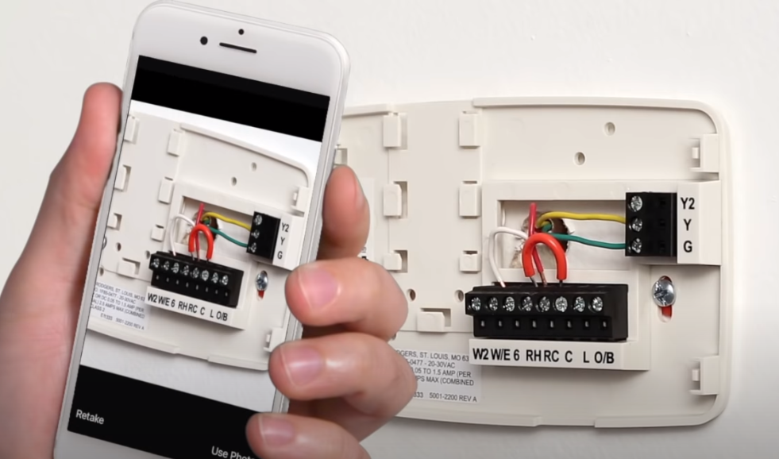
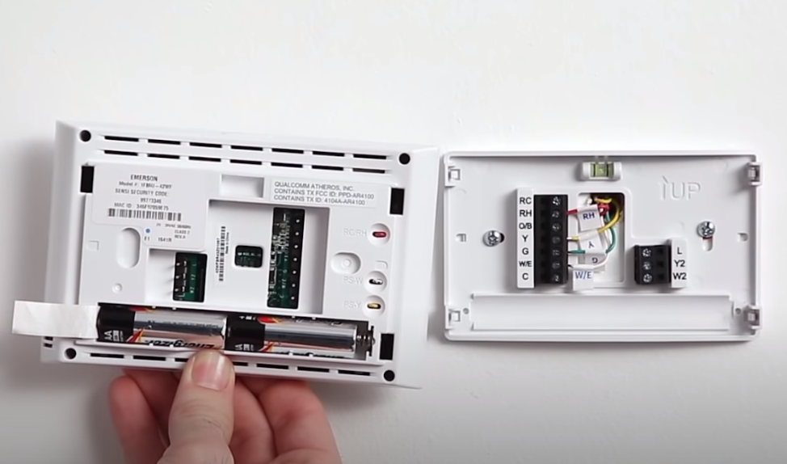
Wiring a Sensi Thermostat
Wiring (Wi-Fi is not required for Sensi installation or operation)
Turn off power
Take pic of wire setup
Disconnect old stat
Connect the new stat

Slide 39
Wiring a Sensi Thermostat
10
1
2
3
4
5
8
6
9
7
10
1
RC Power for cooling, 24V
5
G Indoor blower (fan)
9
Y2/* 2nd stage cool or
Heat Pump 2nd stage heat/cool
(or humidifier)
2
RH Power for heating, 24V
6
W/E 1st stage heat or Heat Pump
1st stage auxiliary/emergency heat
3
O/B Heat pump changeover or
3-wire zone (configure as O, B or 2)
10
W2/* 2nd stage heat or
Heat Pump 2nd stage auxiliary/emergency
heat (or dehumidifier)
7
C Common wire, 24V
Y 1st stage cool or Heat Pump 1st stage heat/cool
L Heat Pump “L”
terminal connection
10
4
8

Slide 40
System Configuration Menu
Press Menu.
This will display the first item in the configuration menu. Press Menu to advance to the next menu item.
Press the UP or DOWN buttons to change a menu item option.
TECH TIP: Most technical service calls are the result of improper system configuration. Ensure you reference your installation guide for appropriate system selection during installation.
1F87U-42WF

Slide 41
Configuration Options Summary
DISPLAY CODE | MENU ITEM | CONFIGURATION OPTIONS
- | Wireless Setup Connects Thermostat to Wi-Fi network | Connect
F | Fahrenheit or Celsius | F, C
AC2 | Outdoor Equipment Configuration A/C or Heat Pump | AC1 – Conventional Cooling 1 (Single Stage) AC2– Conventional Cooling 2 (Two-Stage) HP1 – Heat Pump 1 (Single Stage) HP2– Heat Pump 2 (Two-Stage) AC0– No Cooling
EL2 | Indoor Equipment Configuration Gas or Electric Heat | EL1– Electric 1 (Single Stage) EL2– Electric 2 (Two-Stage) Fan Only GA1 Gas 1 (Single Stage) GA2 Gas 2 (Two-Stage)
O | Reversing Valve Position “O”, "B” or 3-Wire Zone Valve "2" | O (energized constantly in cool) B (energized constantly in heat) 2 (energized constantly when not calling for heat)
Fn OFF | Comfort Circulating Fan | Off/10% – 100% (5% increments)
H AA OFF | Humidification Add Accessory | Off/On
H SP OFF | Humidification Set Point | Off/5% – 50% (5% increments)
dH AA Od | Dehumidification Add Accessory | Od/Oc Od – Optimal dehumidification (Overcool to dehumidify) Oc – Optimal comfort (Wired dehumidification)
dH SP OFF | Dehumidification Set Point | Off/40% – 95% (5% increments)
ON | Wireless Radio Turns Wi-Fi Radio On/Off | Off/On

Slide 42
Configuration Options In App
FEATURE | DESCRIPTION
Remote Access | Adjust, control, schedule or monitor from anywhere, anytime
Usage Reports | Monitor current day and historical heating, cooling and fan run times
Contractor-On-Call | Contact your HVAC Pro when you need service
Dashboard | View and control multiple thermostats
Geofencing | Switches settings between Home or Away based on your location
Program a Schedule | Create one, or multiple time/temperature setting schedules
Keypad Lockout | Lock out changes at the thermostat but retain Wi-Fi control
Temperature Limits | Allow thermostat adjustment only within the temperature range you select
Set Point Controls | Select the temperature range for automatic changeover between heat/cool
Boost | Allow fast staging when the temperature is adjusted 3 or more degrees
A/C Protection | Five minute time delay between cooling or heat pump cycles
Adjustable Cycle Rate | allows fast, medium or slow cycle rates
Temperature Offset | Adjust temperature display +/- 5°
Circulating Fan | Select daily fan run time percentage even if heat or cool is not running
Maintenance Reminder | Calendar Date or Usage (runtime)
Air Filter Reminder | Calendar Date or Usage (runtime)
UV Bulb Reminder | Calendar Date or Usage (runtime)

Slide 43
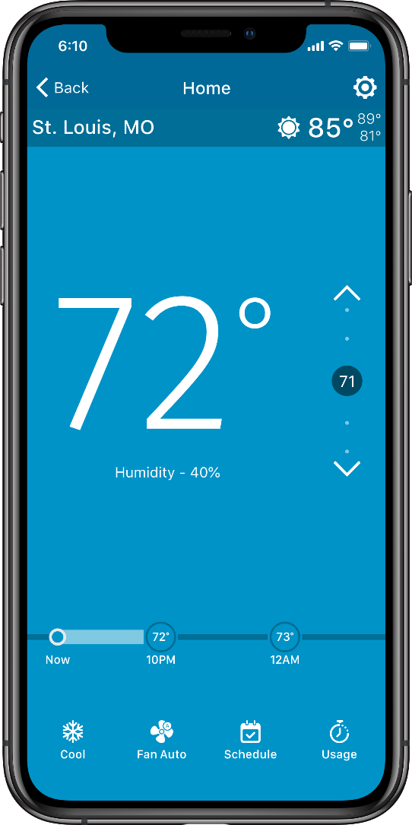
Control Options and Scheduling
Sensi has multiple control options to fit any schedule or lifestyle:
Adjust manually anytime/anywhere
Geofencing
Set a schedule or multiple schedules - change or adjust anytime
The Sensi app lets you adjust temperature for comfort or economy while home or away.
2
1
3
4
10
5
1
BACK TO DASHBOARD
6
USAGE DATA
2
THERMOSTAT NAME
7
SCHEDULING OPTION
3
SETTINGS
8
FAN MODE OPTIONS
4
WEATHER
9
SYSTEM MODE
5
SET TEMPERATURE
10
ROOM TEMPERATURE
9
8
7
6

Slide 44
Geofencing
Saves energy when you are away by adjusting 3° lower heat or higher cool based on your phone, or multiple phone locations
3° setback happens automatically when geofenced phones are 3 or more miles away.
Just Tap Scheduling, then Geofencing.
EXAMPLE: Joe and Jane live in a condo. Joe turns on geofencing. Now when Joe leaves the thermostat sets back 3 degrees. If Jane turns on geofencing in her phone, set back will not happen until both Joe and Jane leave the home.

Slide 45
Scheduling
The Sensi app is easy for people with a fixed schedule to use with a simple step-by-step format to:
Use the factory pre-programmed schedule
Create custom heat/cool schedules
Copy, customize and store multiple schedules
Override, change or cancel schedules
Energy Saving Defualt Program
 | *WAKE UP (MORNING) |  | LEAVE FOR WORK (DAY) |  | *RETURN HOME (EVENING) |  | GO TO BED (NIGHT)
Heating Program | 6:00 AM | 70°F | 8:00 AM | 62°F | 5:00 PM | 70°F | 10:00 PM | 62°F
Cooling Program | 6:00 AM | 75°F | 8:00 AM | 83°F | 5:00 PM | 75°F | 10:00 PM | 78°F

Slide 46
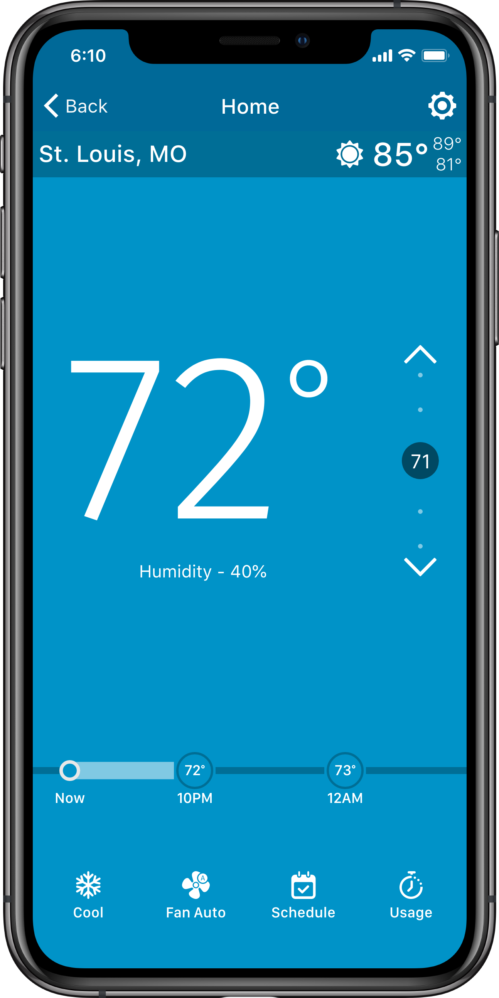
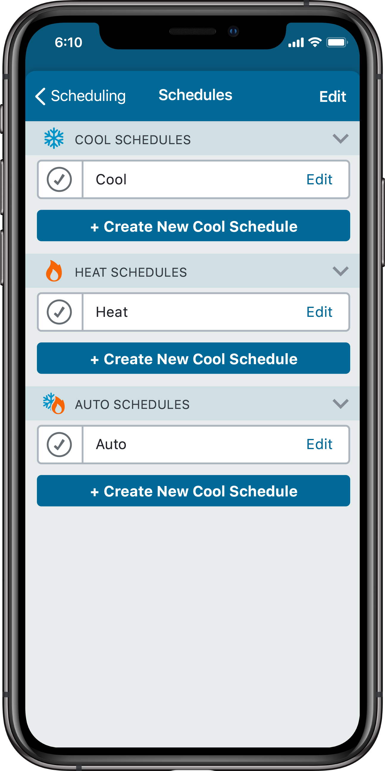
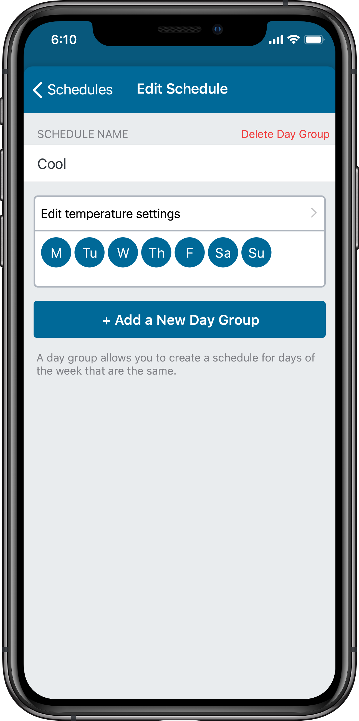
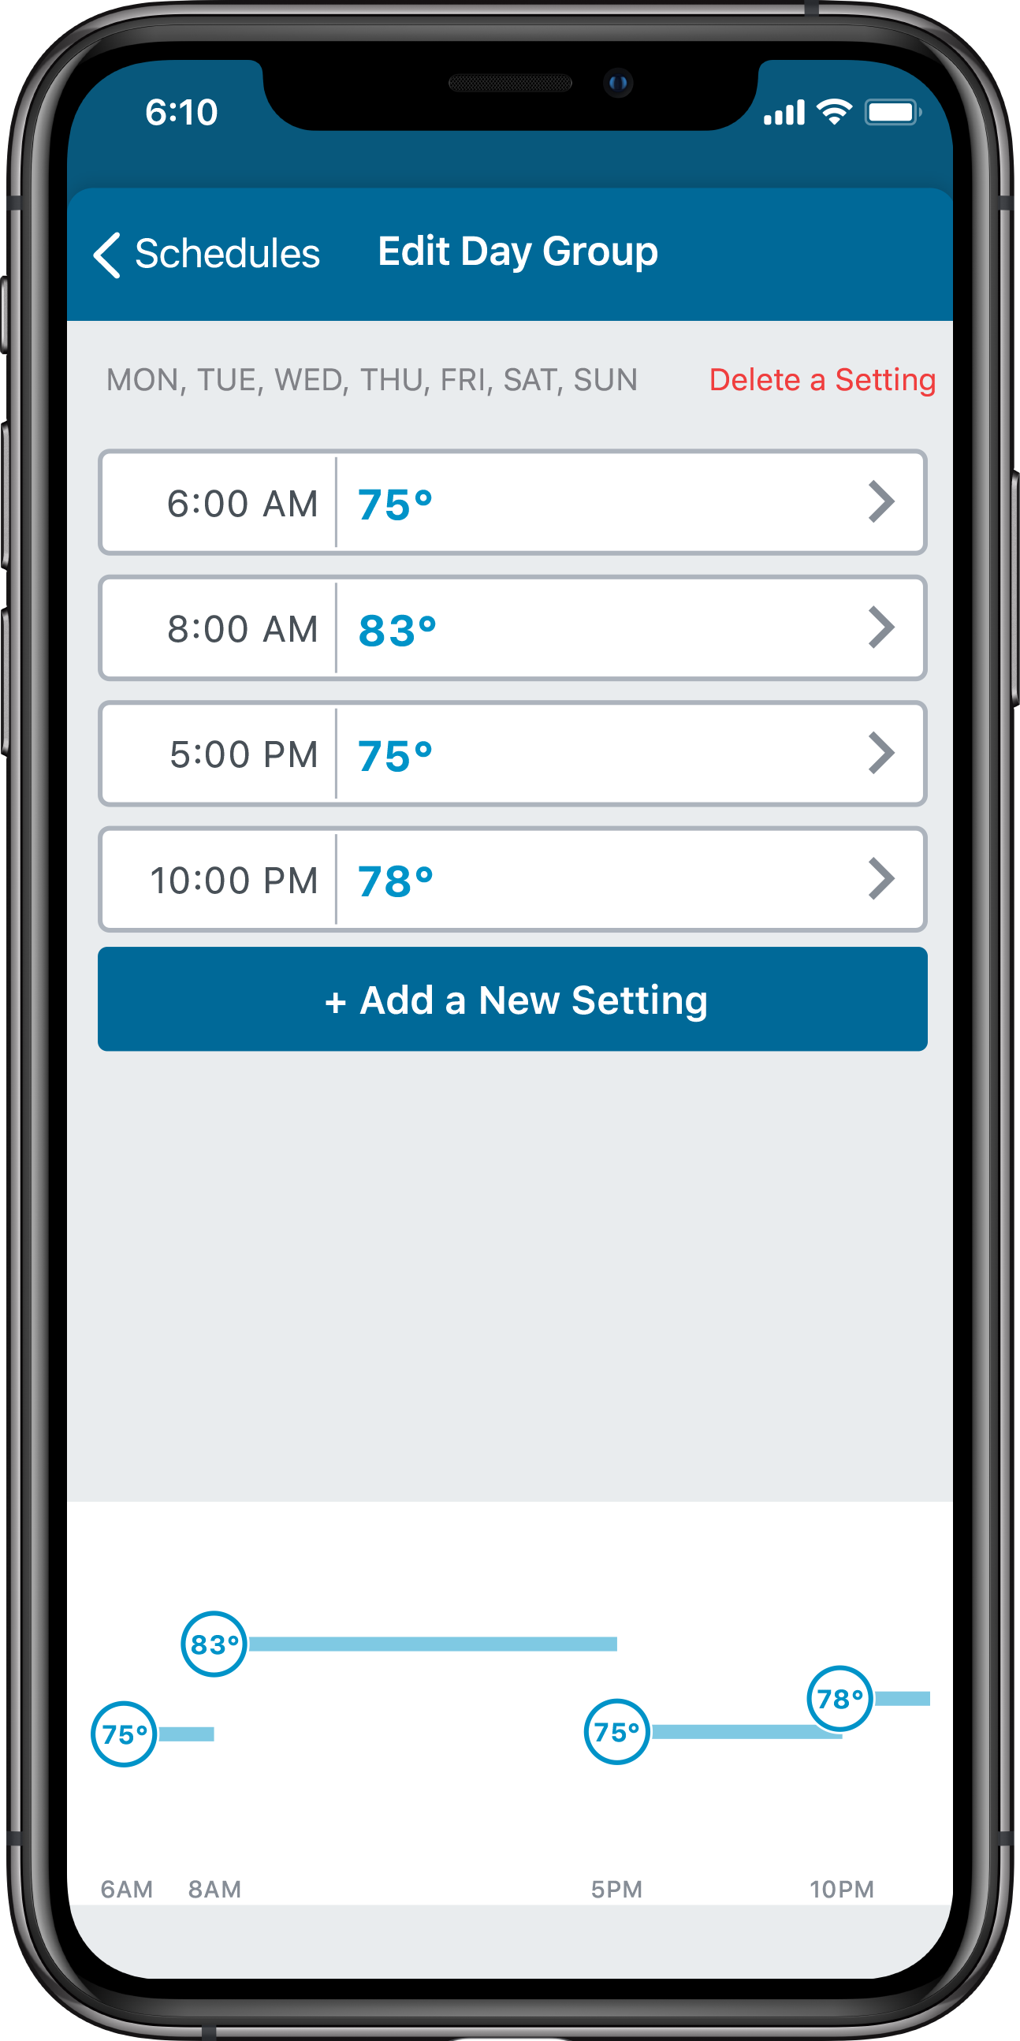
Scheduling Continued
1
Press Schedule and select Edit Schedules
2
Choose a schedule to edit or create a new one
3
Select the days
4
Set Time/Temp

Slide 47
Sensi Thermostat - System Troubleshooting
SYMPTOM | POSSIBLE CAUSE | CORRECTIVE ACTION
No Heat/ No Cool/ No Fan (common problem) | 1. Blown fuse or tripped circuit 2. Furnace power switch to OFF 3. Furnace blower compartment door panel loose or not properly installed 4. Loose connection to thermostat or system | 1. Replace fuse or reset breaker 2. Turn switch to ON 3. Replace door panel in proper position to engage safety interlock or door switch 4. Tighten Connection
No Heat | 1.) Heating System requires service or thermostat requires replacement | 1. Diagnostic: Set Mode to Heat and raise the setpoint above room temperature. Within five minutes the thermostat should make a soft click sound and “Heating” should appear on display. This sound indicates the thermostat is operating properly. If the thermostat does not click, try resetting the thermostat. If the thermostat does not click after being reset, contact your heating and cooling service person or place of purchase for a replacement. If the thermostat clicks, verify the heating system is operating correctly.
No Cool | 1. System not set to Cool 2. Loose connection to the thermostat or system 3. Cooling System requires service or thermostat requires replacement | 1. Diagnostic: Set Mode to Cool and lower setpoint below room temperature. Same procedures as diagnostic for “No Heat” condition except set the thermostat to Cool and lower the setpoint below the room temperature. There may be up to a five minute delay before the thermostat clicks in Cooling if the AC Protection feature is on.
Heat, Cool or Fan Runs Constantly | Possible short in wiring, thermostat, heat, cool, or fan system. | Check each wire connection to verify they are not shorted or touching other wires. If the condition persists, try resetting the thermostat.

Slide 48
Sensi Thermostat – Wi-Fi Troubleshooting
SYMPTOM | POSSIBLE CAUSE | CORRECTIVE ACTION
No Wi-Fi Icon | 1. Low batteries 2. Common wire required 3. Lost Wi-Fi credentials | 1. Replace batteries if battery icon indicates low batteries 2. If Wi-Fi turns off after about two hours, the issue is likely due to the system not providing a common path for power sharing. Add common connection. 3. Put Sensi in Wi-Fi setup mode and reconnect to Wi-Fi.
X Icon or X and Wi-Fi | 1. Unsuccessful Wi-Fi connection 2. Lost connection 3. Wi-Fi router incompatibility or high firewall setting 4. Servers down | 1. Incorrect home network password, retry with correct credentials 2. Signal strength or interference. Reposition router, turn off additional devices until the cause is isolated. 3. Power cycle router off then on. Check router compatibility online at Sensi,emerson.com and use recommended Wi-Fi settings. 4. Check server status online.
App Error | 1. Cannot Create Secure Connection/Unable to connect to Sensi Network 2. Can't Connect to Sensi in Wi-Fi settings 3. Provisioning Error 4. Configuration Error 5. Authentication Error 6. Network Scan Error | 1. Check the security code is entered correctly, turn off mobile Data, turn off network switch, force close app, forget networks, ensure the correct path has been selected, reboot thermostat and phone, and reset Network Settings on the phone. 2. Spinning icon, check for full battery icon, reset phone and thermostat. 3. Reset router, phone, and thermostat. Make sure router security has recommended settings. Try another device. 4. Hard reset the thermostat and force close the app. 5. Check that the home Wi-Fi Network Password is correct. Forget network password and reconnect. 6. SSID needs to be reformatted to eliminate 'non-standard' characters or symbols.
HomeKit Error | 1. Can't add accessory 2. Incompatible router 3. iCloud data sync in progress | 1. Turn on Home Date in iCloud settings, turn on Keychain, hard reset the thermostat. 2. Connect to the 2.4GHz instead of the 5GHz. Toggle off "Auto Join". 3. Wait for the sync to complete. They may need to delete something if the storage is full. Update device, toggle Keychain off and on, log in and out of iCloud, reset HomeKit Configurations. Bypass bypass HomeKit (select "22") and add later.

Slide 49
Why Contractors Trust White-Rodgers
Industry Leading Products
Used by more OEM’s
Offering the widest range of Universal Replacement Controls
Ease Of Installation
Simple, easy to understand instructions
Product Reliability
Quality Control assures reliable products
Affordable
Competitive pricing
Supported By Knowledgeable Representatives
Contractor direct phone support
R-5197-02

